Slide 1
Introduction to Computer Programming
Lecture 7

Slide 2
For Loops: what & why
%% cycle through repetitive tasks
for ii = 1:7
%% Each Day
Wake up
Coffee
Shower
Work
Gym
Netflix
Bed
end

Slide 3
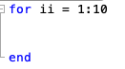
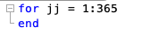
Nested Loops
What happens if you put a loop inside a loop?
Inner Loop
Outer Loop

Slide 4
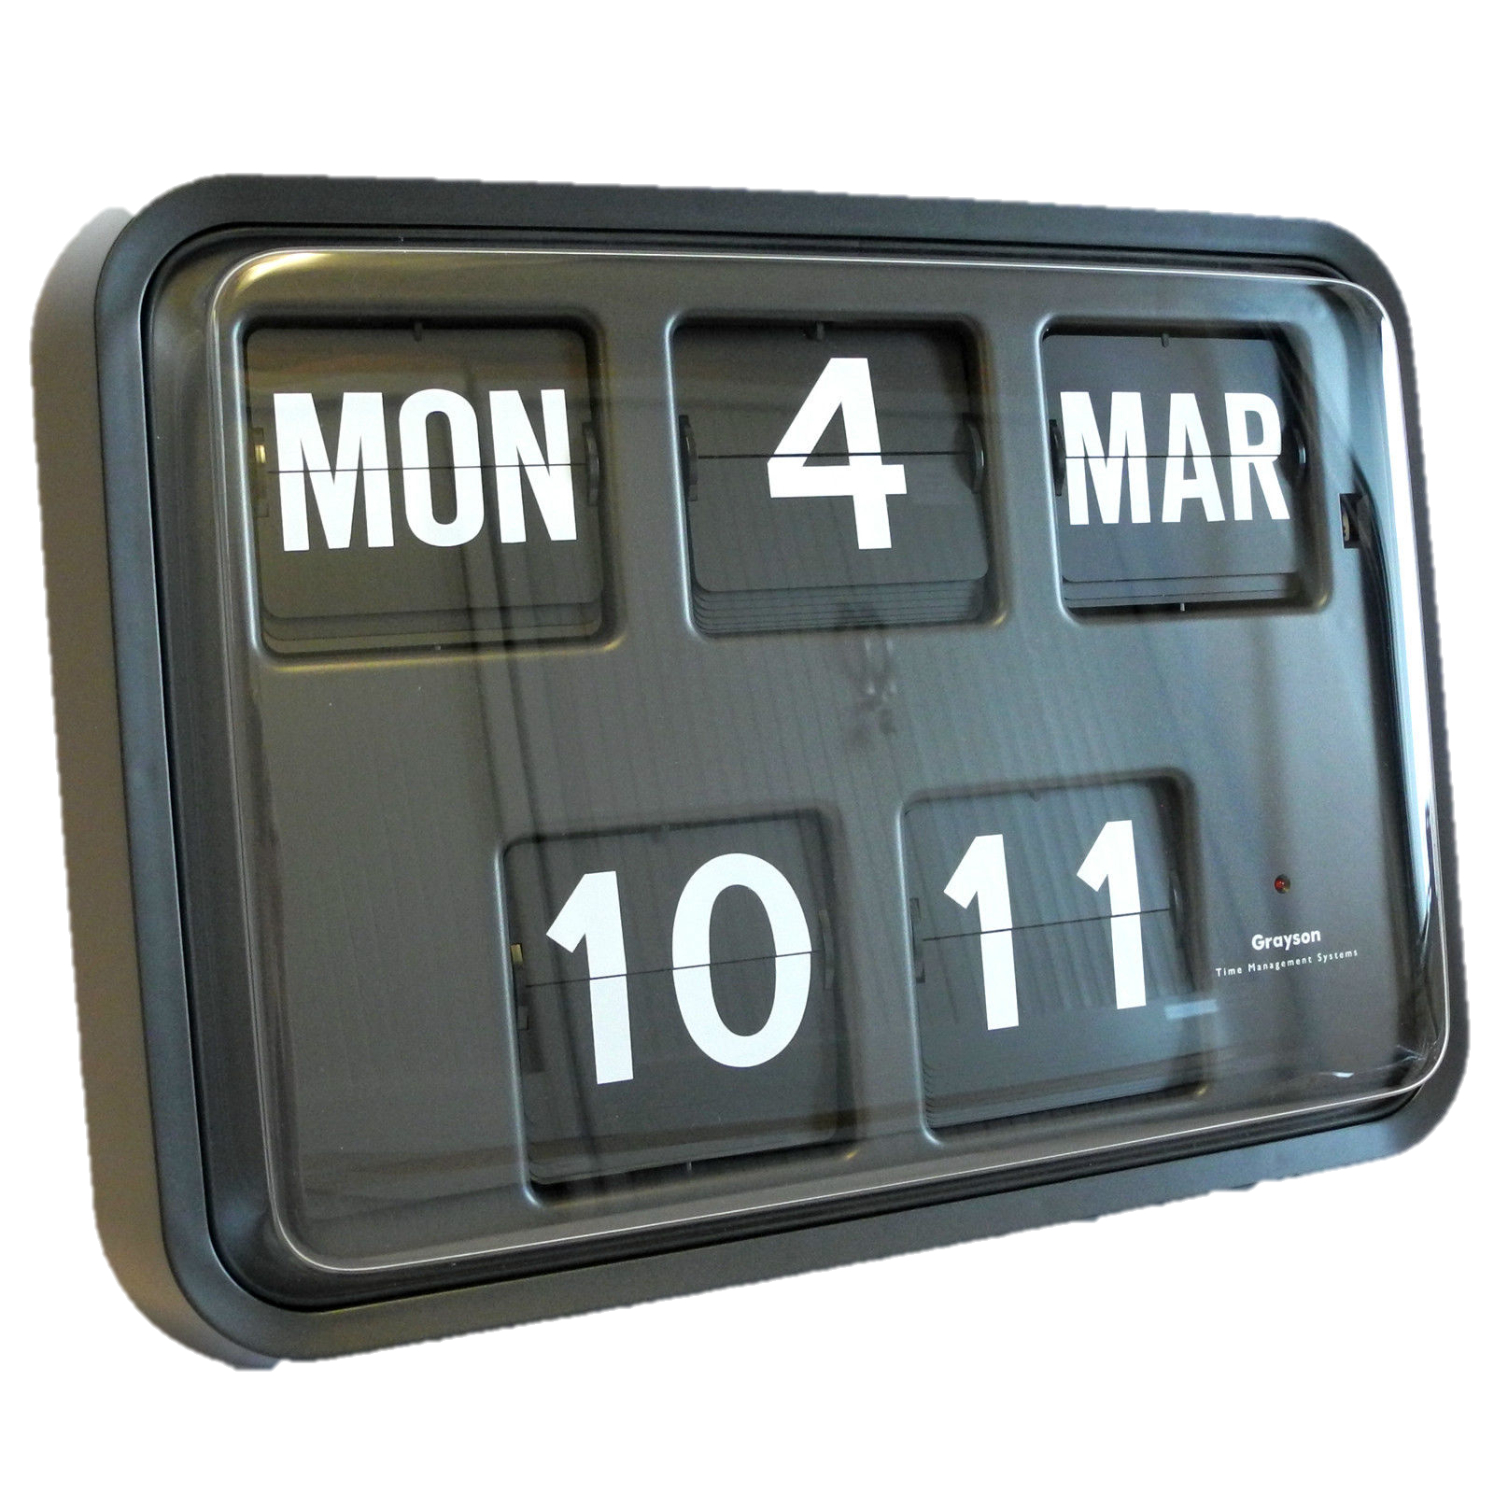
Nested Loops
for days=1:7 % outer loop
for hours=1:24
for minutes=1:60 % inner loop
[days hours minutes]
end
end
end
How many minutes in a week?

Slide 5
Nested Loops
myCounter=0;
for days=1:7 % outer loop
for hours=1:24
for minutes=1:60 % inner loop
myCounter=myCounter+1
end
end
end

Slide 6
Other Loops
Count in increments > 1
for days=1:7:31
days
end
Count backwards
for days=10:-1:1
days
end

Slide 7
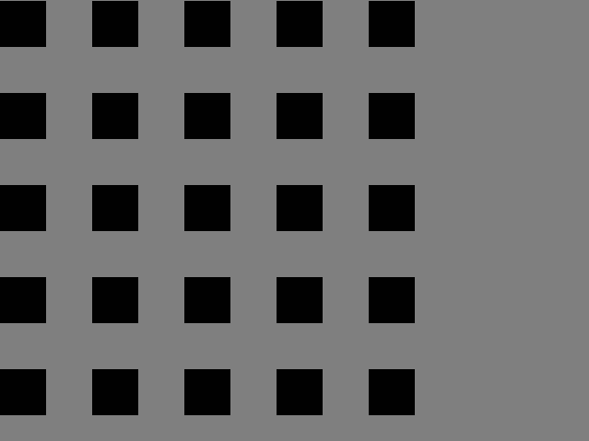
Todays Example
%% clear work space
clear all
close all
%% Constants
rectSize=100;
gridSize=5;
displaySize=gridSize*rectSize;

Slide 8
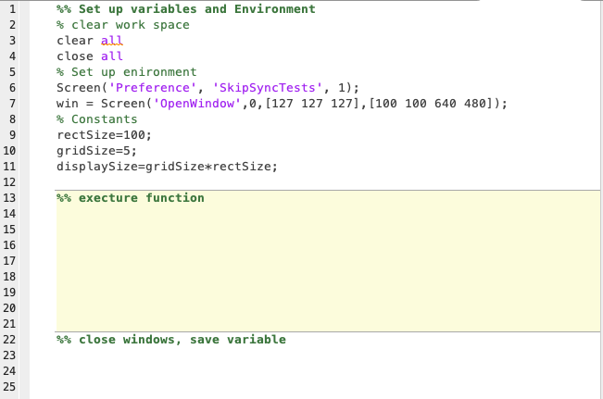
Script Organisation
Using constants allows flexibility, transparency and error mitigation.

Slide 9
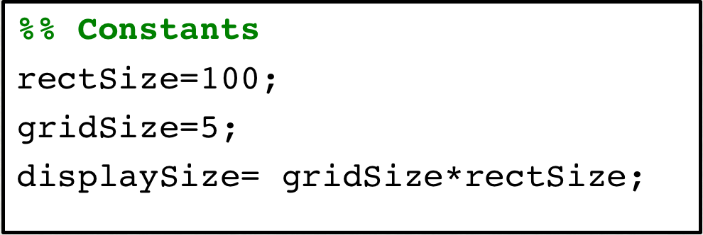
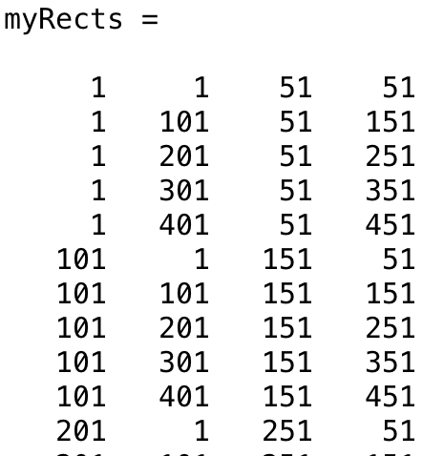
Complicated Nested Loop
%% Code
rectCount =0; % to count the rectangles
% nested loop
for x=1:rectSize:displaySize% outer loop
for y=1:rectSize:displaySize % inner loop
rectCount = rectCount+1
myRects(rectCount,:)=[x y x+rectSize/2 y+rectSize /2];
end
end
1: 100 : 500
[Left Top Right Bottom]
“/2” because I only want our rectangles to cover half the space.
rectCount=2
The “ : “ here
Means ’all-the-columns’

Slide 10
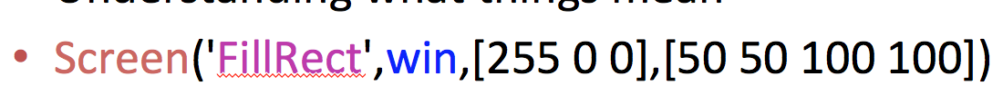
Rectangles
[Left Top Right Bottom]
[Left Top Right Bottom]
loop through

Slide 11
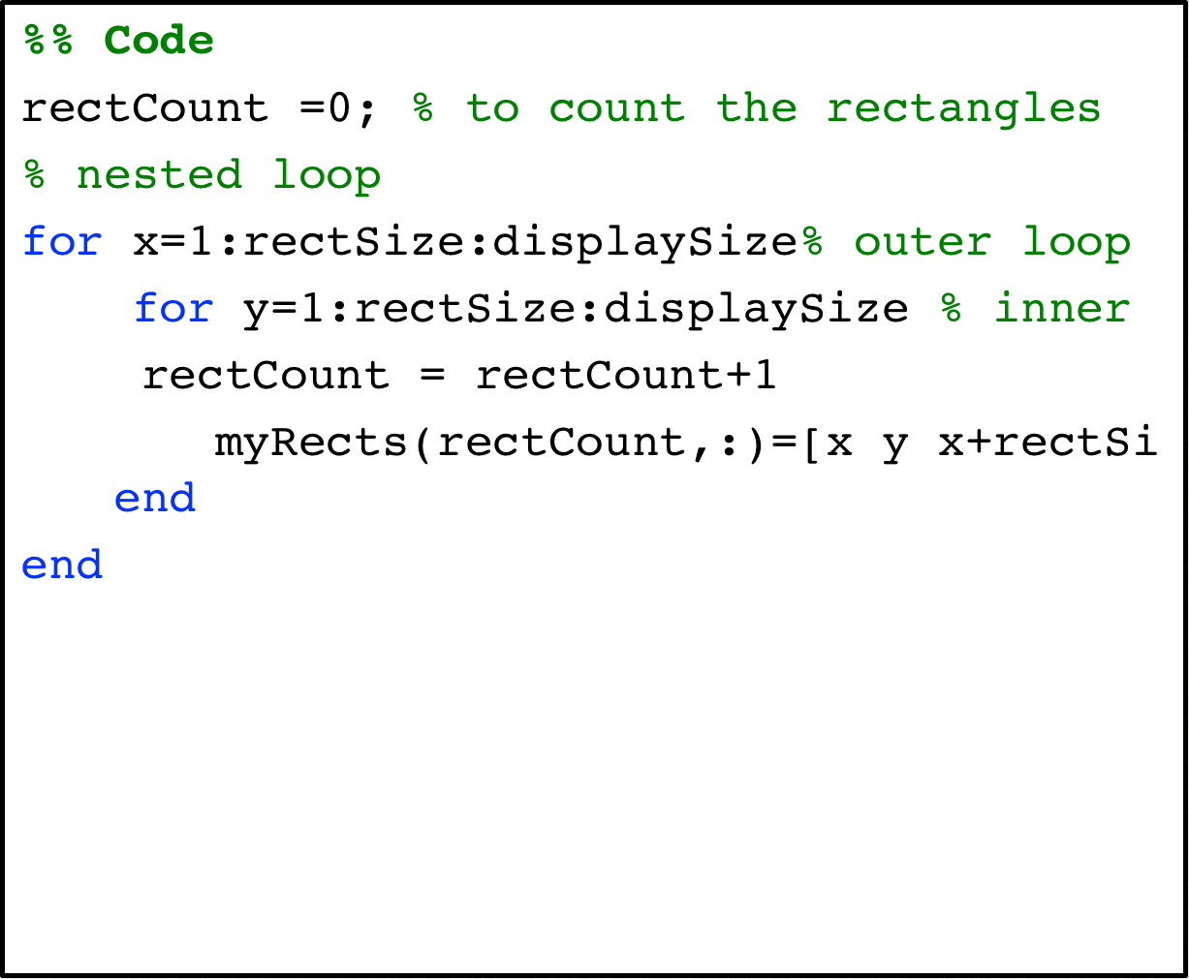
Using myRects
%% Draw the grid in PTB
% Open PTB window
% loops through the myRects
% and draw each rectangle on the screen
% close the loop
% flip the screen

Slide 12
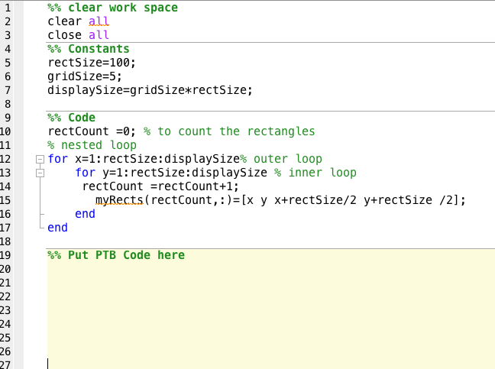
Using myRects
%% Draw the grid in PTB
% Open PTB window
[win screenRect]=Screen('OpenWindow',0,[127 127 127],[0 0 640 480]);
totalNumberRect=rectCount;
for k=1:totalNumberRect % loops through the myRects
Screen(win,'FillRect',[1],myRects(k,:)); % and draw each rect
end % close the loop
Screen(win,'Flip') % flip the screen

Slide 13
Small-Group Exercises
---- ex 1 ----
Create a version of this script
---- ex 2 ----
Can you change the number of rectangles
---- ex 3 ----
Can you change the size of the rectangles
---- ex 4 ----
You can add a single number to an array
A=[5 6 7;
2 6 2;
9 3 0]
B=A+5;
Can you work out a way to place the rectangle near the centre of the screen?

Slide 14
Small-Group Exercises
---- extra ----
---- ex 5 ----
Can you change the colour of each rectangle somehow using the counter
---- ex 6 ----
Can you repurpose the code to draw an (any) image instead of the rectangles

Slide 15
Key Concepts
Equations
Matlab Functions
Variables
Matrices
While loops
If statements
For loops
Array indices
Other arrays
Organising scripts
Keyboard Input
Nested Loops
Mouse Input
Screen Coord’s

